Slide 1
Analysis of COVID-19:
Delta Variant
Bibek Dhungel
Anirudh
Dixa
Harshith
Paderborn | 12.08.2021

Slide 2
Contents
Overview
Task 1
Dataset and Preprocessing
Delta Variant Worldwide
Delta Variant UK, India and Russia
Delta cases VS Total cases
Task 2
Task 3
1. Datasets and Preprocessing.
2. Feature Engineering.
3. Model Approximation.
4. Trained Model future prediction.
5. Drawing Conclusion.
Task 4
1. Summarizing Previous Tasks.
2. Interpreting of Preventing.
3. Preventive measures from Government.
6. Conclusion

Slide 3
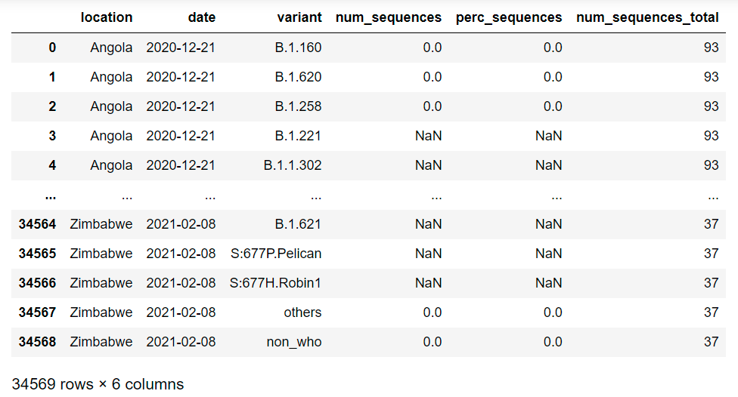
Task 1
Dataset and Preprocessing
The Dataset contains bi weekly data of COVID 19 cases
Data is available according to countries and the variants of COVID 19
The fields in the dataset shown represents:
Date: Bi weekly till 7th August 2021
Variant: Cases from each variant
num_sequence: No of positive cases
perc_sequence: Percentage of each variant to total cases
num_sequence_total: Total positive cases
Actual number are the cases that has been specifically tested for Variants.

Slide 4
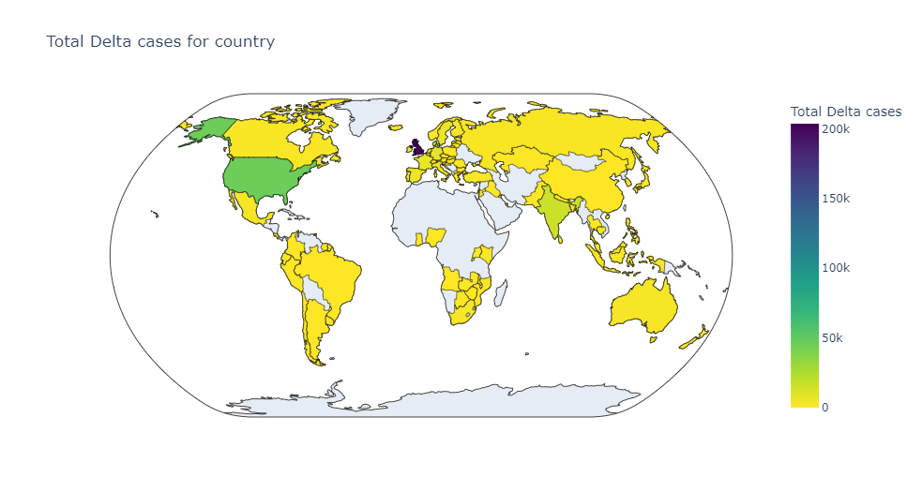
Delta Variant Worldwide

Slide 5
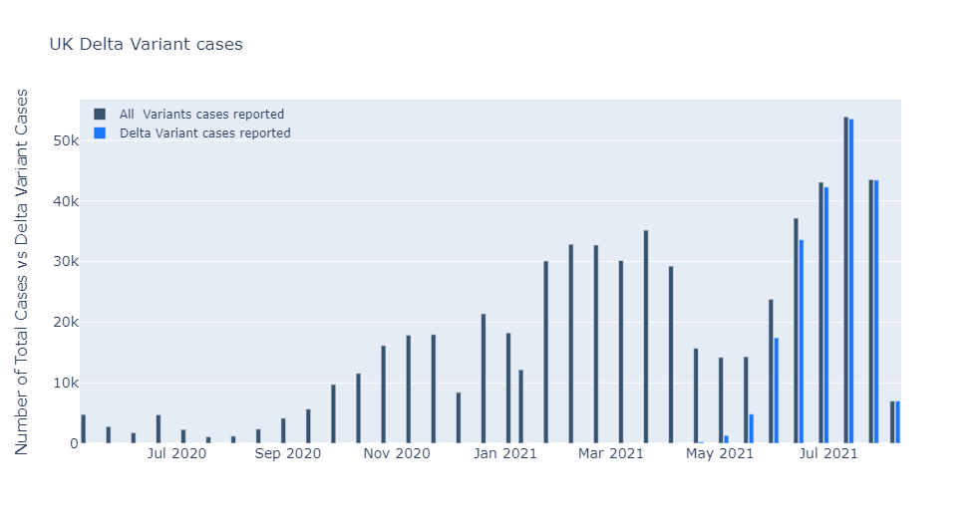
Delta Variant UK

Slide 6
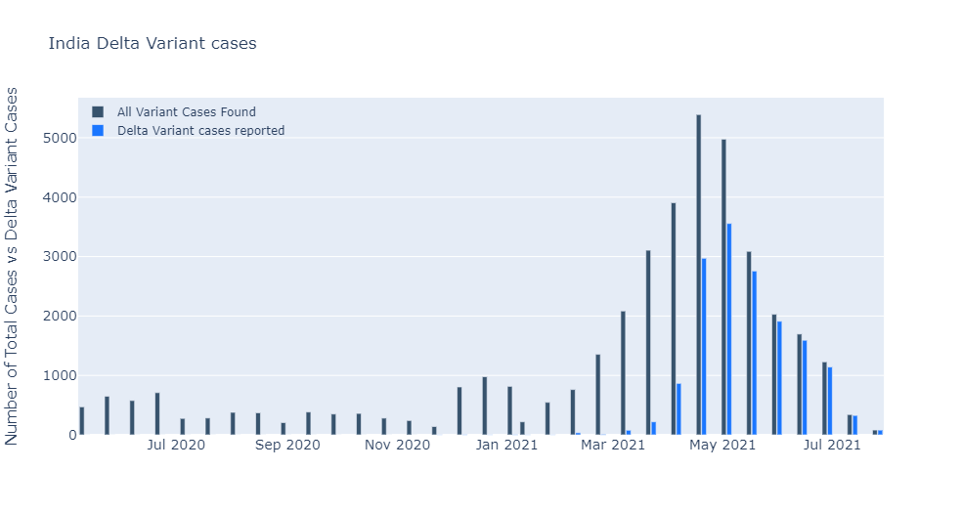
Delta Variant India

Slide 7
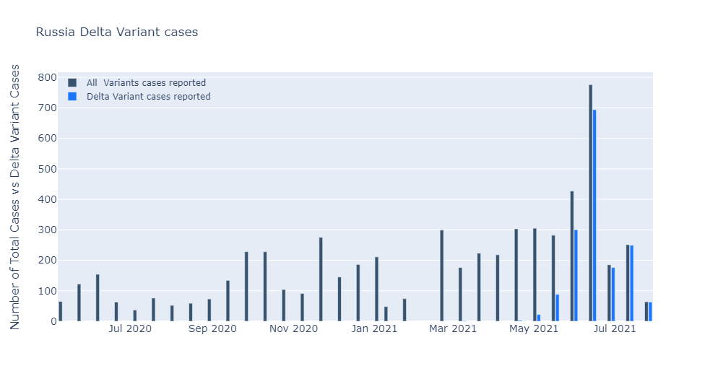
Delta Variant Russia

Slide 8
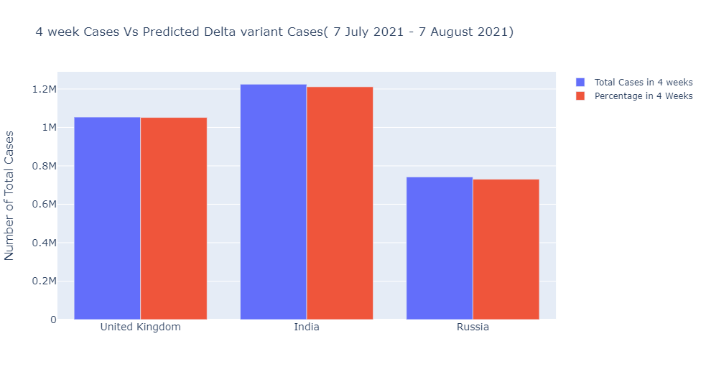
4 Week Total Cases VS Delta Variant

Slide 9
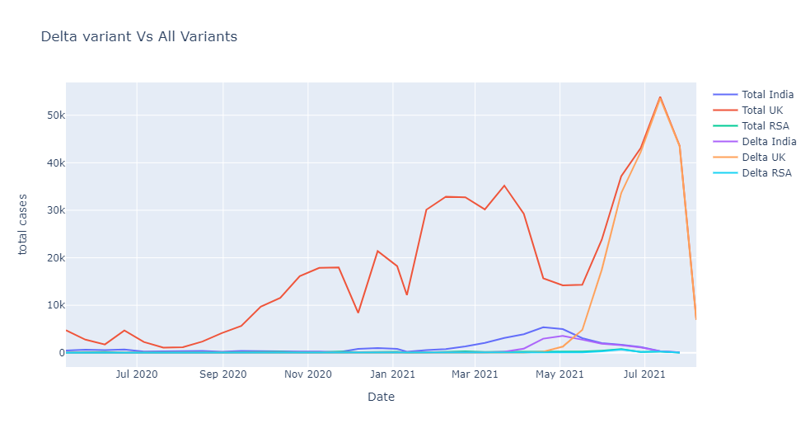
Total Cases VS Delta Variant

Slide 10
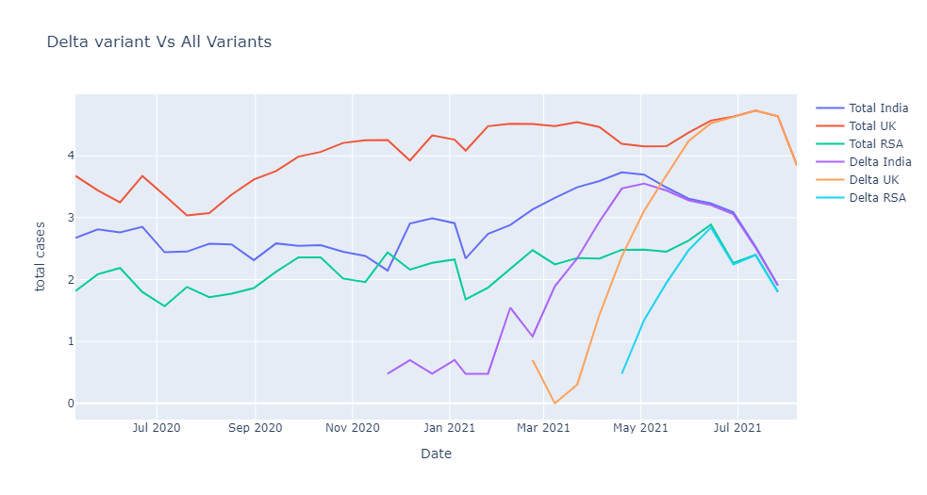
Total Cases VS Delta Variant (Logarithmic)

Slide 11
Task 2
Datasets used are from slide 3
Different factor has helped delta variant to spread. Cultural, religious, summer vacations, lockdown measures all have directly affected the delta variant situation in each countries.
The countries that have none to few restrictions has seen an exponential rise in the cases whereas the countries with somewhat decent or strict lockdown has few.
We will explore some of the causes of rise in delta variant in following slides.

Slide 12
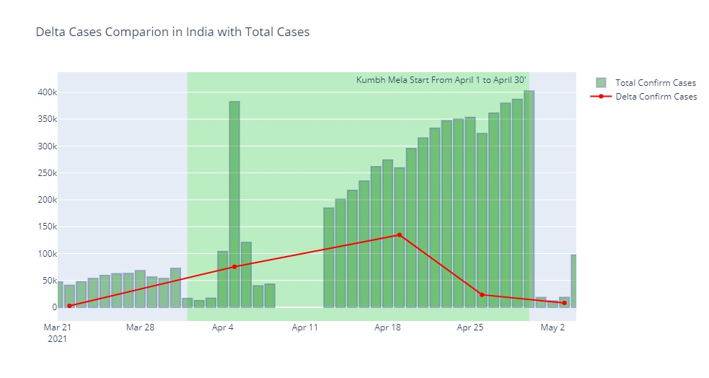
India: Cultural Event vs Positive Cases

Slide 13
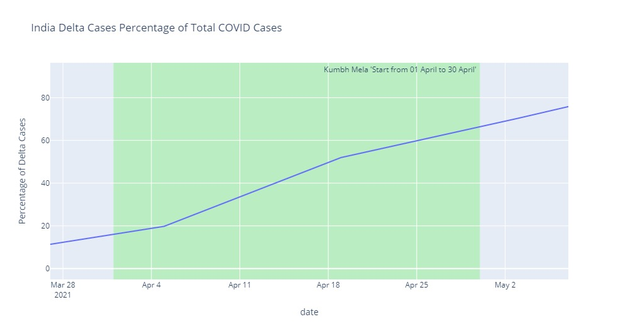
India: Rise of Delta during the period of mass gathering

Slide 14
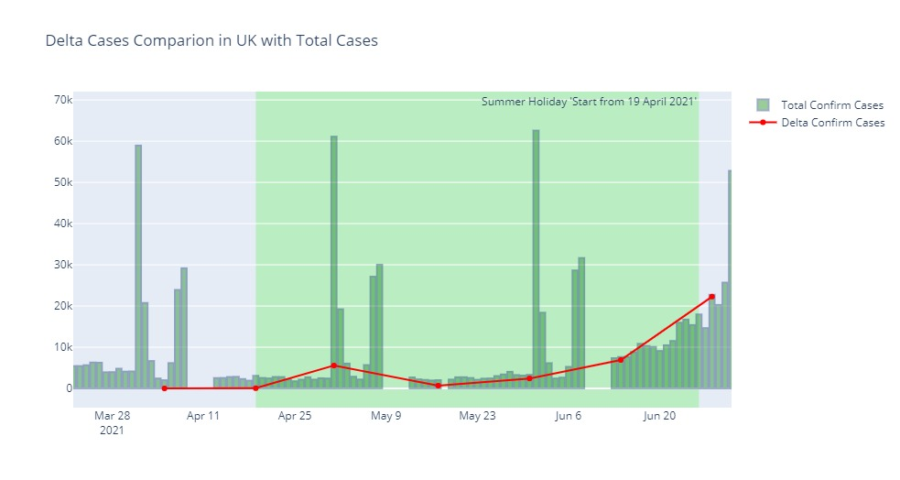
UK: Rise of Cases in Summer holiday

Slide 15
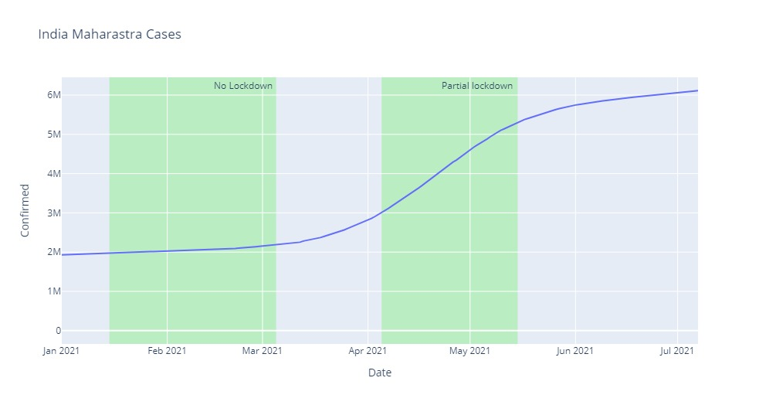
India (Maharastra): Lockdown effects to positive cases

Slide 16
Task 3
Agenda
The Delta Variant analysis in Germany.
Look into the Datasets and have Insights into it.
Building a SARIMAX Model to analyse the current and Future Situations in Germany.
Drawing Conclusion as how the Delta Variant is affecting the current COVID situation in Germany and how it affects in future at the end of September.

Slide 17
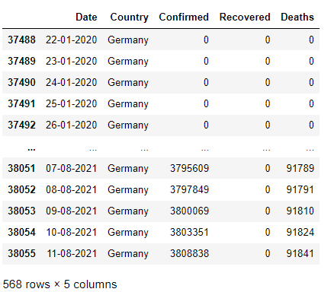
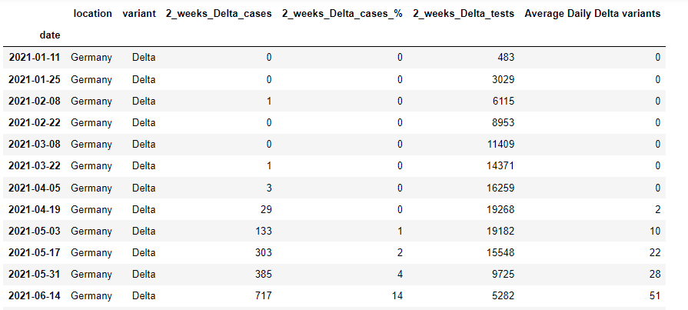
Insights
Datasets and Pre-processing.
The Delta and normal COVID datasets have been used.
This dataset talks about the 2 weeks Delta cases have been found for total number of tests done for all other variants.
The datasets are pre-processed according to Germany cases, also The first Delta case in Germany was reported in February 2nd week.

Slide 18
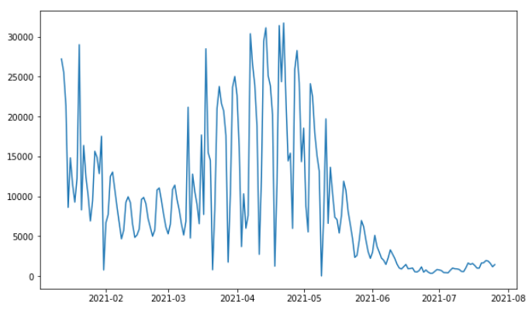
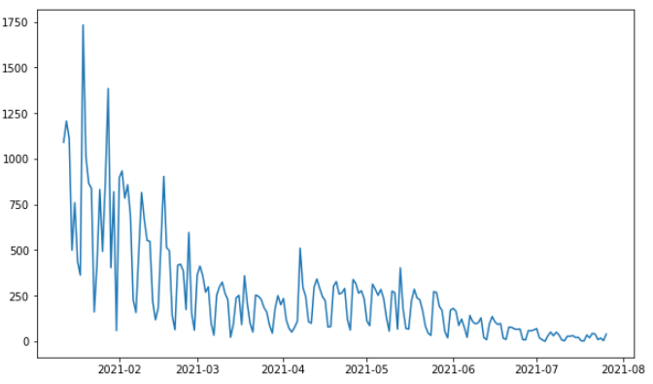
Insights
Feature Engineering
The Seasonal Auto-Regressive Integrated Moving Average is a regressive model used to calculate, predict and analyse the seasonal data like COVID cases, temperatures and other factors that appear in seasonal behaviour.
It is mainly used for Time series analysis like if the situation in time t, and how it changes in time t+1 by calculating the moving average for seasonal patterns.
Line plot of everyday COVID cases in Germany.
Line plot of everyday COVID deaths in Germany.

Slide 19
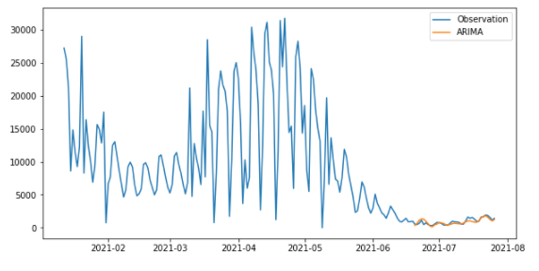
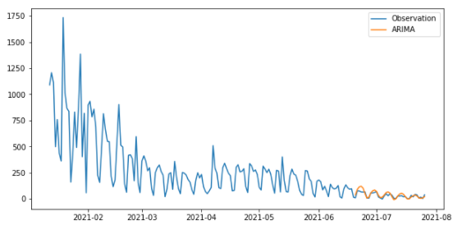
Insights
Model Approximation
The orange line representing the model predicted values as it almost predicted correctly to the real cases and deaths. We can see that the approximation is almost accurate.
Line plot for approximation

Slide 20
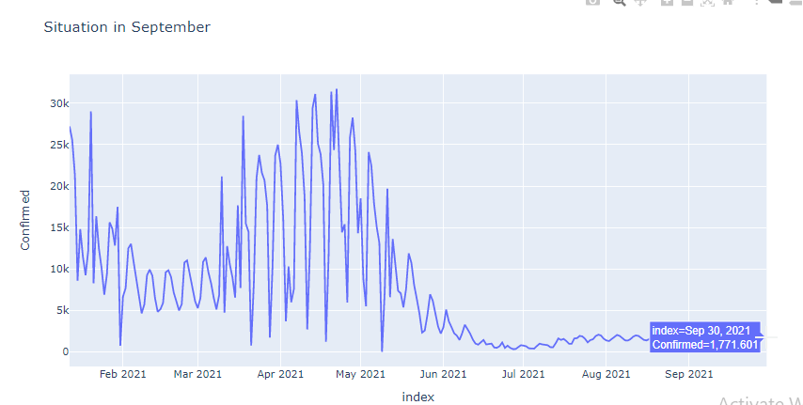
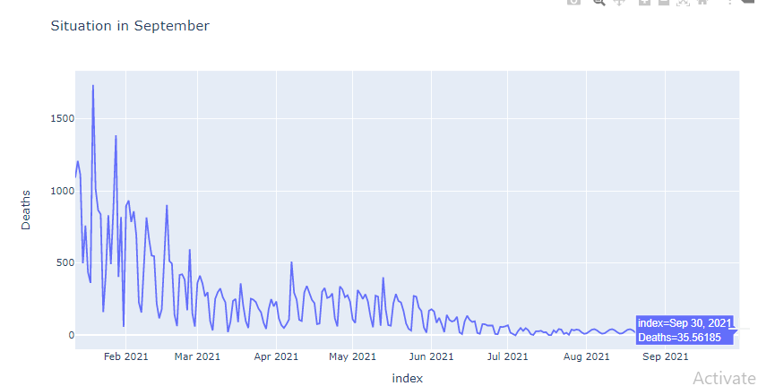
Insights
Trained Model future prediction
Predict the COVID situation in the September using the trained model.
The COVID cases in August and in September would be around 1500 to 2000 on an average every day. Similarly, the deaths in August and September would be around 40 to 50 every day on an average.
Predicted Cases plot from August to September.
Predicted deaths plot from August to September.

Slide 21
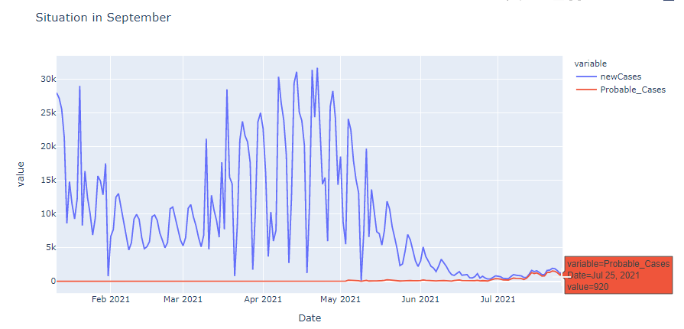
Insights
Drawing Conclusion
Blue lines represent the daily COVID cases from Jan 2021 to July 2021 and we can observe the COVID cases have been decreased gradually from June till end of July.
The number of cases reported at the end of July is 1423 and according to Delta variant tests more than 90% of the cases are Delta so we can say that the orange line representing the probable Delta cases.
By the end of July, the Delta cases reported daily on an average is 1149. Hence the total cases for COVID are getting reduced as many people are vaccinated but most of the cases are Delta Variants.
new COVID cases and probable Delta cases.

Slide 22
Task 4
Agenda
Summarizing the previous tasks.
Interpreting the reason that helped controlling COVID cases and Delta Variants.
As German Government to take necessary steps to avoid infections like Delta.

Slide 23
Insights
Summarizing previous tasks.
The Delta Variant in Europe is spreading faster as it has reached peak in United Kingdom. So the strain has come to Germany in January last week and continued to spread across all the states up to 90% of the total cases.
From the above tasks we can infer that the rise of delta variants was the result of various factors like mass gathering, vacations, lockdown measures etc.
From task 2 we can see the rise of delta variant and overall cases rises significantly during the festival of Kumbh Mela. The ease of lockdown is also significantly responsible for the surge in cases.
Observing the delta variant data all over the world Germany is still managing to have kept the delta variant under control.
This can be given credit to the long lockdown, probation of gatherings, cancelled festivals etc.

Slide 24
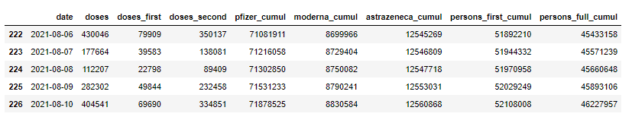
Insights
Interpretation of Preventing.
One of the main reason is vaccination.

Slide 25
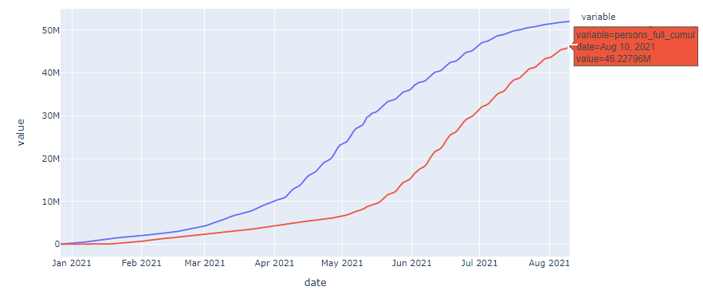
Insights
Interpretation of Preventing.
we can see that the vaccination rate from May to August has increased very fast as almost over 50 Million people have been received 1st dose and more than 40 million people have been received both the doses.

Slide 26
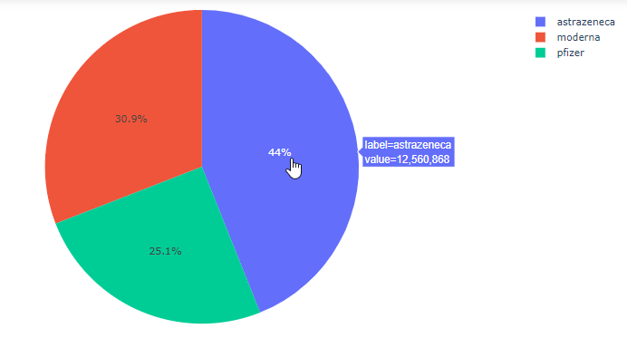
Insights
Interpretation of Preventing.
The higest is Astra Zeneca where it is used by almost 44% and 12 Million doses have been administred and then followed by Moderna and Pfizer.

Slide 27
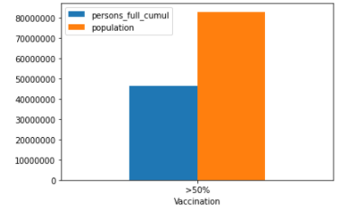
Insights
Preventive Measures Government can take.
we can see that almost 50% of the people have been fully vaccinated and if the German Government succeeds vaccinating 100%, continue following certain rules like Social Distancing, Wearing Masks, Getting rt-pcr done while travelling far and avoid public gathering the Delta variants and also other COVID variants can be avoided.

Slide 28
Conclusion
Covid – Delta first reported in INDIA ( February 2021)
INDIA – United Kingdom – Russia top 3 Delta variant countries
Reasons: Public Gatherings, Summer Holiday, Ease of Lockdown Restrictions
Based on SARIMAX, we found that by September 2021 Germany will have
1500 to 2000 daily cases and 40 to 50 deaths every day (average)
Germany Government has to focus on Vaccination and shouldn’t ease the restrictions to control Covid - Delta!

Slide 29
Thank You..
Questions?

